Slide 1


GaME OF LIFE
TEAM : SATHI
MEMBERS:BAO TRAN, BhagyashreeARAS, SUPRAJA AMRUTHA, MIA LEE

Slide 2
CLASSIC GAME

Slide 3
Twist to game

Slide 4
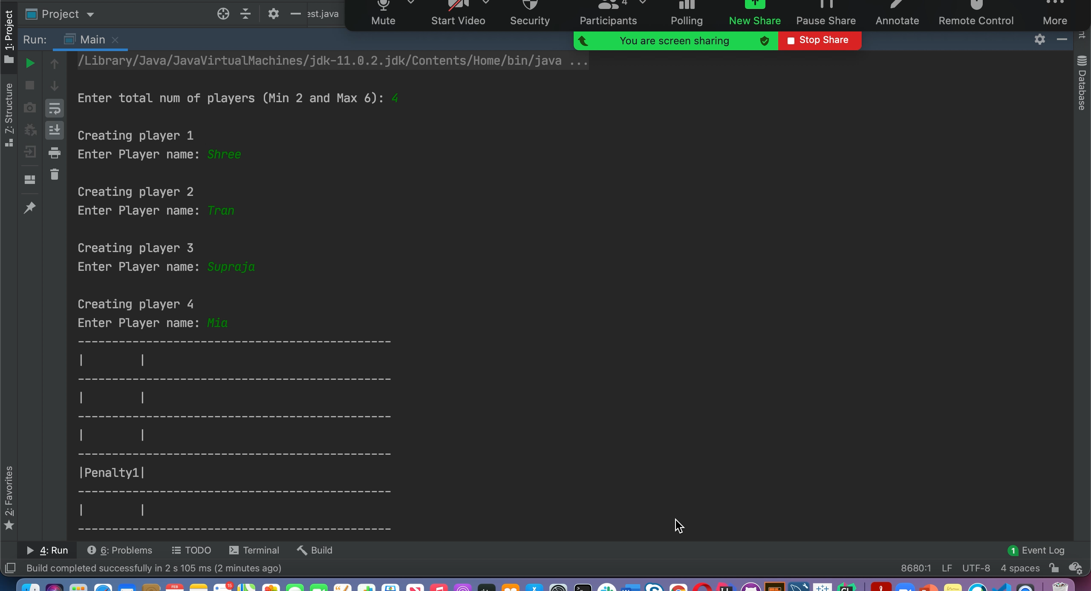
DEMO

